Slide 1
EENG 284 - Lab 8 simpleDatapath

Slide 2
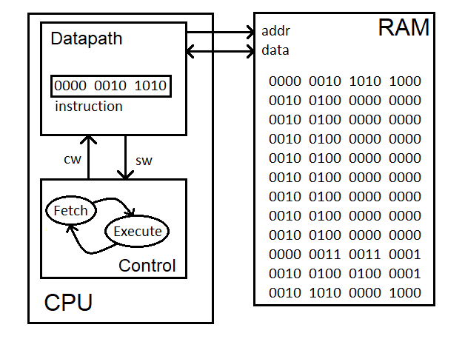
Computer basics?
Memory shared between instructions and data
Datapath performs operations
Control unit sequences operations

Slide 3
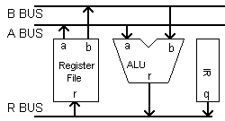
Datapath
Instructions stored in instruction register (IR)
Register file has 8 registers, each 16-bits wide – holds program vars
Arithmetic Logic Unit performs 9 different operations
Busses move data around in datapath

Slide 4
Instructions
I type LDI #value, RD
I stands for immediate
Load a constant value into a register
R type ADD RS1, RS2, RD
R stands for result (from the ALU)
Performs an operation on a register in the register file
 | 15 | 14 | 13 | 12 | 11 | 10 | 9 | 8 | 7 | 6 | 5 | 4 | 3 | 2 | 1 | 0
I | 0 | 0 | 0 | x | x | immediate |  |  |  |  |  |  |  | dest
R | 0 | 0 | 1 | fnc |  |  |  | selA |  |  | selB |  |  | selR

Slide 5
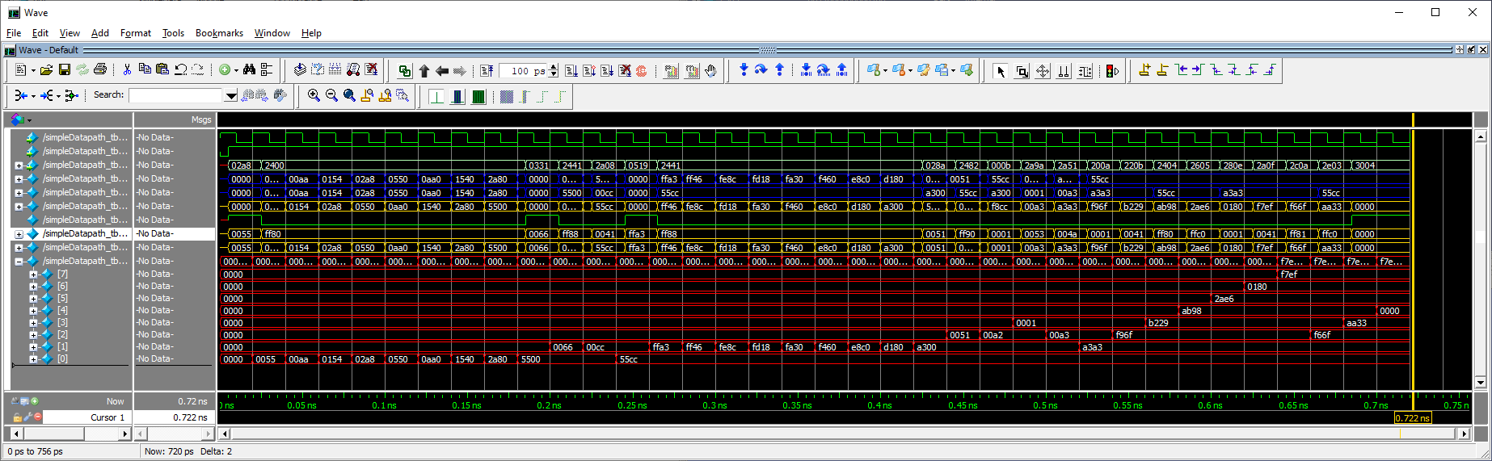
Deliverables
ALU testbench
Register File testbench
simpleDatapath testbench

